Slide 1
Design and Building Practitioners Scheme
Get ready for 1 July 2021 – start now
Office of the Building Commissioner
May 2021

Slide 2


Foreword
The Design and Building Practitioners Scheme (the D&BP Scheme) comprises the Design and Building Practitioners Act 2020 (the D&BP Act), the Design and Building Practitioners Regulation 2021 (the D&BP Regulation) and the Ministerial Order 2021. It is being introduced as part of the Construct NSW reforms – a once in a generation opportunity to reform the residential construction industry. The commencement of the D&BP Scheme on 1 July 2021 adds an important layer to the regulation of the residential industry setting up a registration regime and design and building declaration regimes. These start on 1 July 2021.
A key feature of the reform is the participation of industry in the development of policy and approach. The Pillar 4 Working Group (“Strengthening Contracts”) has worked to develop this Getting Ready Guide to assist industry participants get ready: Carrie Metcalfe (MinterEllison and Property Council of Australia); Andrew Chew (Corrs); Nick Luzar (Chair) and Jeremy Ell (Master Builders); Laura Cockburn (Institute of Architects); Baoying Tong / Colin Lim (Engineers Australia); Kristy Eulenstein (Consult Australia).
Their expert and generous contributions are gratefully acknowledged
Eleanor Naughton and Elizabeth Stewart,
Office of the Building Commissioner

Slide 3




The D&BP Scheme commences on 1 July 2021. It introduces new obligations for professionals working on Class 2 buildings.
The final Design and Building Practitioners Regulation 2021 is now available here.
There are two new registration schemes being introduced:
1.
2.
Registration of Professional Engineers
Compliance Declaration Scheme for Design and Building Practitioners
Click for more information on Professional Engineers, click here
Click for more information on Design & Building Practitioners, click here

Slide 4












The D&BP Scheme applies to buildings that are Class 2, or contain a Class 2 component
A Class 2 building is a building containing two or more sole occupancy units, with each being a separate dwelling (NCC Vol 1, A6.2)
Examples of include:
Single storey attached dwellings with common basement carpark
Dwelling with a granny flat vertically attached
Multi-residential apartment buildings
Examples of mixed use buildings with a Class 2 component:
Apartment building with a carpark
Apartment building with shops on the first floor
Apartment building with offices occupying some floors

Slide 5
Exempt building work is outside the regime
You don’t need to register or make compliance declarations for excluded or exempt work including:
Work which is carried out as “Exempt development”
Work done in compliance with a s124 Local Council order or development control order
work done under a contract where a party received a HomeBuilder grant
Work that is exempt from a provision of the BCA by the EPAA
See clause 13 of the Regulation for all of the excluded types of work

Slide 6
Who needs to register under the D&BP Scheme?
Design practitioners who prepare a regulated design for a class 2 building, or a building that contains a class 2 component
Professional engineers who undertake professional engineering for a class 2 building, or a building that contains a class 2 component
Building practitioners who are undertaking building work on a Class 2 building, or a building that contains a class 2 component
Registration via the Service NSW website will open from 1st July.

Slide 7
Registering as a Professional Engineer

Slide 8






Professional Engineers – who needs to register?
Professional engineers working on Class 2 buildings (or buildings that contain a Class 2 part) in the following areas of engineering are required to register under the D&BP Scheme:
Civil engineering
Geotechnical engineering
Electrical engineering
Mechanical engineering
Fire safety engineering
Structural engineering
From July 1, eligible professional engineers working on Class 2 buildings (or buildings that contain a Class 2 part) must register via the Service NSW portal. Following 7 July, you will need to stop doing professional engineering work until you have submitted your application.
Professional engineer must be an individual and not a company
Registration via the Service NSW website will open from 1st July.

Slide 9
Registering as a Design or Building Practitioner

Slide 10

Who needs to register under the D&BP Scheme?
Design practitioners who will declare designs of a Class 2 building, or a building that contains a part 2 component, are required to register under the D&BP.
Each category of Design Practitioner is authorised to produce and provide compliance declarations for certain types of regulated designs. A construction project will require a range of registered design practitioners, each bringing a different specialty. It is important that you read the D&BP Regulations to understand the detail on each design practitioner category
Please note that:
It is possible to register in more than one class of Design Practitioner if your work overlaps several disciplines
Only registered design practitioners can make declarations for regulated designs that they have personally prepared or varied, or that have been prepared or varied by others and they’ve supervised or coordinated this work
Registered Professional Engineers are authorised to carry out professional engineering work. However, if any of the professional engineering work involves the preparation of a regulated design, the preparation of that design needs to be supervised or coordinated by a registered design practitioner in the relevant class who will make the declaration, or the engineer will need to register a second time as a design practitioner for the relevant class in order to make the declaration themselves.

Slide 11
Who needs to register under the D&BP Scheme?
Design practitioners who will declare designs of a Class 2 building, or a building that contains a part 2 component, are required to register under the D&BP.
Each category of Design Practitioner is authorised to declare certain types of designs. A construction project will require a range of registered design practitioners, each bringing a different specialty. It is important that you read the regulations to understand the detail on each design practitioner category.
Classes of Design Practitioner:
design practitioner—architectural
design practitioner—body corporate
design practitioner—building design (low rise)
design practitioner—building design (medium rise)
design practitioner—civil engineering
design practitioner—drainage
design practitioner—drainage (restricted)
design practitioner—electrical engineering
design practitioner—façade
design practitioner—fire safety engineering
design practitioner—fire systems (detection and alarm systems)
design practitioner—fire systems (fire hydrant and fire hose reel),
design practitioner—fire systems (fire sprinkler)
design practitioner—fire systems (mechanical smoke control)
design practitioner—geotechnical engineering
design practitioner—mechanical engineering
design practitioner—structural engineering
design practitioner—vertical transportation

Slide 12

Who needs to register under the D&BP Scheme?
Principal Design practitioners who are undertaking coordination of the regulated designs and compliance declarations on a Class 2 building, or a building that contains a class 2 component, are required to register under the D&BP Scheme.
The Principal Design Practitioner is an optional role.
The role was designed with the bigger, more complex projects in mind. On those projects, hundreds or even thousands of regulated designs need to be lodged and declared. A principal design practitioner can assist in coordinating the many regulated designs declared designs that will need to be prepared and lodged prior to construction commencing.
Classes of Principal Design Practitioner:
principal design practitioner—body corporate
principal design practitioner—general
Registration via the Service NSW website will open from 1st July.

Slide 13

Who needs to register under the D&BP Scheme?
Building practitioners who are undertaking building work on a Class 2 building, or a building that contains a Class 2 component, must register under the D&BP.
The Building Practitioner is the person who is the principal contractor for the building work. Where there is more than one builder on a project, the Building Practitioner must be the Head Contractor.
This role is responsible for making building compliance declarations – they declare that building work is constructed in accordance with declared regulated designs and the BCA.
Classes of Building Practitioner:
building practitioner—body corporate
building practitioner—body corporate nominee
building practitioner—general
Registration via the Service NSW website will open from 1st July.

Slide 14
Registration of Body Corporate as a Design Practitioner
Registration by body corporate as a Design Practitioner or Principal Design Practitioner
A body corporate can register a Design Practitioner or Principal Design Practitioner, but the body corporate must also have an employee who is an individual registered Design Practitioner or Principal Design Practitioner in the appropriate class/es.
A Design Practitioner – Body Corporate can only produce regulated designs and related compliance declarations in the categories that the employee is registered for. For example, if the only registered employee of a body corporate is registered in the class of Design Practitioner – Architectural, the body corporate is only able to prepare regulated designs and make declarations for those designs relevant to the category of Design Practitioner – Architectural. To be registered in multiple categories, the body corporate will likely need a number of individual registered Design Practitioners as employees.

Slide 15
Registration of Body Corporate as Building Practitioner
Registration as a Building Practitioner
A body corporate can register as a Building Practitioner, but the body corporate must also have an employee who is an individual registered as either a Building Practitioner – Body Corporate Nominee or as a Building Practitioner – General.
The body corporate would need to also hold a contractor licence, and the nominated employee would either need to hold a supervisor certificate or an endorsed contractor licence under the Home Building Act 1989.

Slide 16
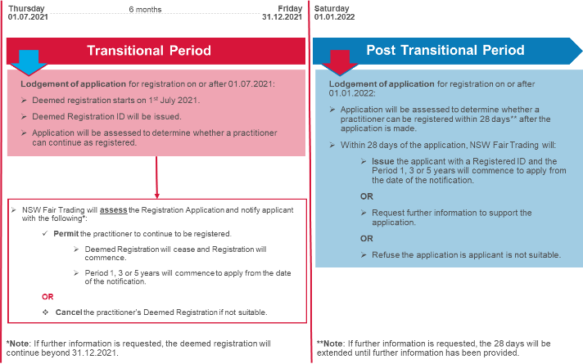
Deemed Registration from 1 July 2021
Registration will open on 1st July via the Service NSW website

Slide 17
What is the Compliance Declaration Scheme?

Slide 18
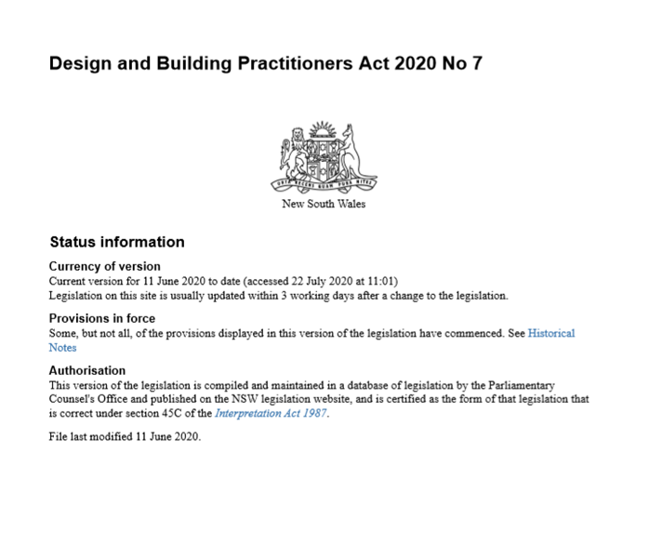




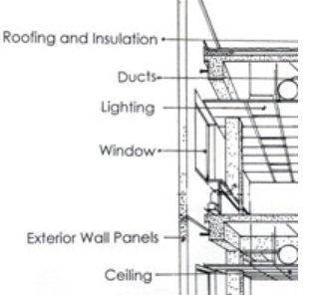
Regulated designs must be declared by an registered design practitioner before construction can begin
Focus on Key Building Elements in Common Property
Architectural / Building Design
Floor plans and plant requirements
Elevations
Sections
Door schedules
Window schedules and detail elevation
Room layout sheets and sheets
…
Structural
Structural concept plans
Structural design plans and details
Structural design sections
Structural elevations
Design loads
Penetration plans coordinated with services
….
waterproofing
DRAFT
Focus on key building elements
Facade
Weatherproofing plans
Elevations
Design fire ratings
….
structure
Fire safety systems
Geotechnical
Shoring design (relating to the below grade wall element
Ground anchor design
Earthworks design
Geological assumptions
….
Fire Safety
Fire Safety Engineer Report
Fire Safety Systems
…
Performance services
Building enclosure
Drainage
Services masterplans
Stormwater systems designs
Electrical
Electrical services
…

Slide 19

Design compliance declarations
Registered design practitioners must make design compliance declarations for regulated designs.
The design compliance declaration will declare:
whether or not a regulated design prepared for building work complies with the requirements of the Building Code of Australia,
whether or not the regulated design complies with other applicable requirements prescribed by the regulations for the purposes of subsection 8(1)(b) of the Act,
whether or not other standards, codes or requirements have been applied in preparing the design,
any other matter prescribed by the regulations.
Note: An approved form for each design compliance declaration, building compliance declaration, principal compliance declaration, and variation statement will be available for download from the NSW Fair Trading Website. Completed forms are required to be lodged onto the NSW Planning Portal.

Slide 20
Building compliance declarations
The Registered Building Practitioner must make a building compliance declaration.
The building compliance declaration will declare:
(a) Whether or not the building work complies with the requirements of the Building Code of Australia.
(b) Whether or not the building work complies with other applicable requirements prescribed by the regulations for the purposes of subsection 8(3)(b).
(d) Whether or not the design was prepared by a registered design practitioner and the building work was built in accordance with the design.
(e) Whether or not a design compliance declaration has been obtained in relation to regulated designs used for the building work.
(f) Whether or not a registered principal design practitioner was appointed in relation to the building work.
(g) Whether or not a principal compliance declaration was obtained in relation to the regulated designs and design compliance declarations relating to the building work
(h) any other matter prescribed by the regulations.
Note: An approved form for each design compliance declaration, building compliance declaration, principal compliance declaration, and variation statement will be available for download from the NSW Fair Trading Website. Completed forms are required to be lodged onto the NSW Planning Portal.

Slide 21
Declarations will happen at four key stages in the design & construction process
The regulated designs, compliance declarations and associated documents to be lodged in the NSW Planning Portal at the following stages:
Stage 1 – before the building work commences. No building work can commence for new projects until ALL designs for the building/development are complete and declared
Stage 2 – as variations arise after building work commences
Stage 3 – before the issue of an occupation certificate
Stage 4 –90 days after issue of an occupation certificate

Slide 22
Design Practitioners – Design Guidelines
Design practitioners must comply with the Regulation Design Guidelines for Design Practitioners
These guidelines explain important information regarding Regulated Designs and Design Compliance Declarations.
Also the Ministerial Order sets out the title block that must be used and other particulars
They can be found at: https://www.nsw.gov.au/building-commissioner/construct-nsw/customer-focused-regulatory-framework

Slide 23







The regulated designs, compliance declarations and associated documents to be lodged in the NSW Planning Portal at the following stages:
1
2
3
4
Before building work commences
After building work commences (i.e. variations)
Before you apply for an occupation certificate
After the occupation certificate has been issued
Documents lodged at this stage:
a copy of each construction-issued regulated design for building work
a copy of each design compliance declaration for regulated designs
the principal compliance declaration (completed on Planning Portal) if appointed.
Building Practitioner must give the Principal Design Practitioner, if there is one, 14 days’ written notice before building work starts.
This gives the Principal Design Practitioner time to collate and complete the principal compliance declaration.
Documents lodged at this stage:
a copy of each varied regulated design
a copy of the regulated design for a new building element or performance solution
a copy of each design compliance declaration for the above designs.
Documents lodged at this stage:
the building compliance declaration (completed on Planning Portal)
a contractor document
a copy of each variation statement required for building work
a copy of any other regulated design that contains additional details not in the construction-issued regulated design, but are not variations
a principal compliance declaration (completed on Planning Portal), if any.
Documents lodged at this stage:
a building compliance declaration
a contractor document
a copy of each variation statement required for building work
a copy of any other regulated design that contains additional details not in the construction-issued regulated design, but are not variations
a principal compliance declaration (completed on Planning Portal), if any.
NOTE: Documents will be uploaded by the Building Practitioner or authorised practitioner

Slide 24

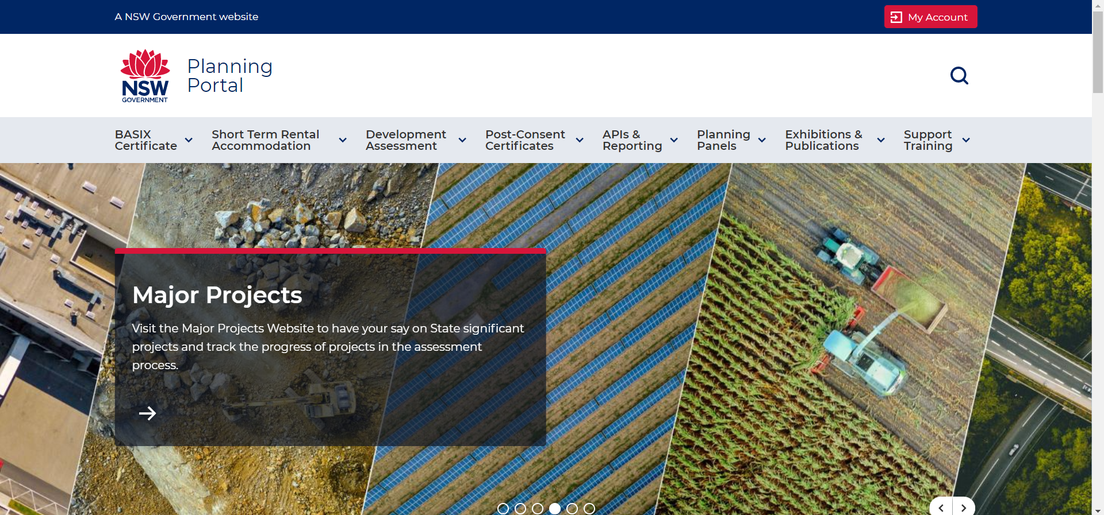
NSW Planning Portal
Registration allows a design practitioner (if authorised) and building practitioner to upload declared designs digitally to the NSW Planning Portal. If you are not registered, you cannot upload.
You should make sure you comply with BCA and standards in doing design or construction work because the work you do will be associated with your registration number and remain on the Planning Portal

Slide 25





Variations
Key consideration: is the variation related to a key building element or a performance solution?
Variations to an aspect of a regulated design unrelated to a building element or performance solution do not need to be signed off by a Design Practitioner but must be recorded by the Building Practitioner in a variation statement.
All variations related to a building element or performance solution will require an registered Design Practitioner to prepare and declare a new design.
Variations on regulated designs must be lodged on the NSW Planning Portal within one day of the varied works commencing, alongside the design compliance declaration form.
Work may need to stop so that the varied design can be prepared and declared within this this timeframe.
The variation statement will need to be lodged prior to the application for an Occupation Certificate and must not include any variations that are building elements or performance solutions (as these require the preparation and declaration of a new, updated design).
Key change
Variations must be lodged within one day of the varied works commencing if related to a key building element or performance solution. If the design cannot be updated, declared and uploaded in this time period building works may need to be paused.

Slide 26
Complete designs before building work started
The role of the building designer will change under the D&BP
The designs must be in a form suitable for a building practitioner to build to, before work starts. After the transition period for existing projects, no building work can commence until the designs for the whole building have been declared
A designer must declare variations and at any time, declared designs must reflect the building work.
This is increased work for the designer practitioners compared to current practice, and provision for variations and site visits (and related costs) must be covered in the contract.

Slide 27
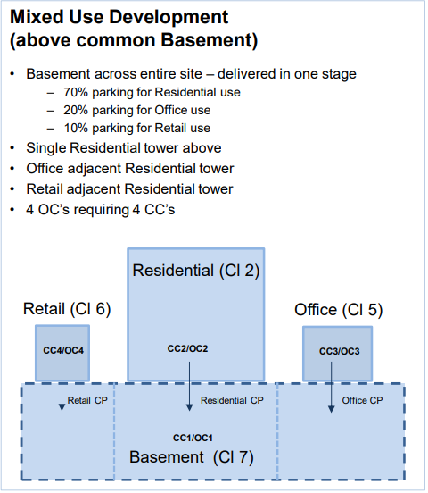
How it works for a mixed use, staged development?

Slide 28
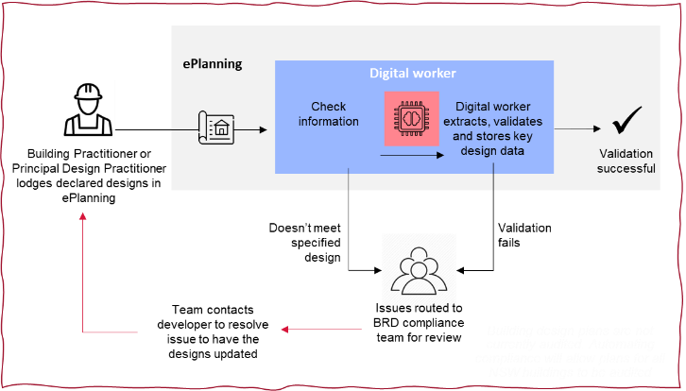
Declared designs will be audits – requirements in Ministerial Orders published soon

Slide 29
Is your project in or out?

Slide 30
The CC/CDC issue date and whether building work has started determine whether projects are in/out
Lodge existing designs but do not need to make compliance declarations prior to the application of an OC.
1
CC or CDC issued before 01.07.2021 AND building work has commenced.
NO
Staged lodgement of declared designs and compliance declarations. Full compliance must be reached prior to the application of an OC.
2
CC or CDC issued after 01.07.2021 AND building work not commenced.
Staged lodgement of declared designs and compliance declarations. Full compliance must be reached prior to the application of an OC.
3
CC or CDC issued before 01.07.2021 AND building work not commenced.
4
For staged constructions, any CC or CDC issued before 01.07.2021 and building work had commenced
No need to provide regulated designs nor compliance declarations for the building work started before 1 July 2021.
Staged lodgement of declared designs and compliance declarations for future CCs, and full compliance must be reached prior to the application of an OC.

Slide 31
What impact does the D&BP have on contracts?

Slide 32

Contract: engaging an engineer
Things to cover in engaging an engineer for professional engineering services on a class 2 building, or a building with a class 2 component:
Engineer must be registered under the D&BP Act for the type of work to be done, namely:
        structural engineering,
        civil engineering,
        mechanical engineering,
        fire safety engineering,
        electrical engineering,
        geotechnical engineering.
Engineer must hold insurance

Slide 33
Contract: engaging a building practitioner
The Head Contractor must be a registered building practitioner
A building practitioner must:
build in accordance with declared designs and building work cannot commence until the designs are declared for the whole building/development (after the Transition Period)
have an arrangement with principal so that if a variation is required during the construction phase, the principal can contact the design practitioner/s for the declared design can be updated and declared afresh
declare the building work has been completed in accordance with the declared regulated designs (as varied, if it is). This declaration must match to the declared regulated design
have insurance in place
Whether the works are staged (and more than one construction certificate and occupation certificate is to be issued e.g. demolition and groundworks, structure and cladding and balance of works) or not, the declaration must be made prior to application for the occupation certificate by the relevant building practitioner.
Whether the project has staged CC/CDCs or not, the building work must be signed off prior to application for an occupation certificate.

Slide 34
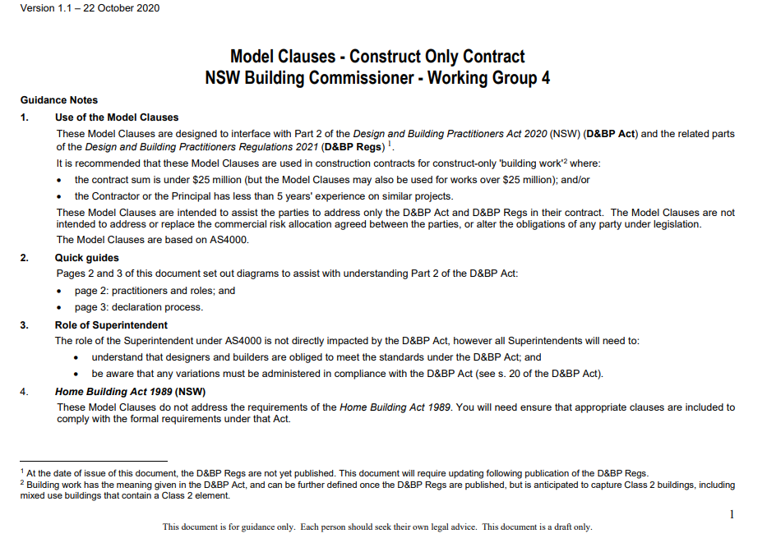

What terms and conditions to consider changing?
Guidance developed by group of industry practitioners
  A construction-only building contract
  A design consultancy agreement
Interpretations
Warranties
Novation
Expected risk
As-builts
Variations
Contractors default
Quick guides, etc..
‘Strengthening contracts and standards’ section of the Construct NSW website

Slide 35
Contract terms: engaging a design practitioner
Contracts will have to reflect the new requirements.
Some suggested changes are set out on ‘Strengthening contracts and standards’ section of the OBC
A construction-only building contract
A design consultancy agreement
In engaging a designer to produce regulated designs for a class 2 building or a building with a class 2 component, the designer must be registered under the D&BP Act for the category/categories relevant to the regulated design/s contracted to produce:
design practitioner—architectural
design practitioner—body corporate
design practitioner—building design (low rise)
design practitioner—building design (medium rise)
design practitioner—civil engineering
design practitioner—drainage
design practitioner—drainage (restricted)
design practitioner—electrical engineering
design practitioner—façade
design practitioner—fire safety engineering
design practitioner—fire systems (detection and alarm systems)
design practitioner—fire systems (fire hydrant and fire hose reel),
design practitioner—fire systems (fire sprinkler)
design practitioner—fire systems (mechanical smoke control)
design practitioner—geotechnical engineering
design practitioner—mechanical engineering
design practitioner—structural engineering
design practitioner—vertical transportation.

Slide 36
Contracts must include:
Permission from design practitioner for a building practitioner to use the regulated designs to build and to use in making a declaration that the building work has been done in accordance with the declared regulated designs AND for other design practitioners to declare variations
Pricing so that the designer can be available for variations during the construction phase – to produce and declare varied regulated designs

Slide 37
Insurance
We recommend that you hold adequate insurance to cover any liability that might arise relating to your new obligations under the D&BP reforms.
There will be a one transitional period from 1 July 2021 to 30 June 2022 during which such insurance will not be mandated as a condition of registration.
This transitional period is intended to enable the insurance industry to develop appropriate products, and to enable you to adjust to your new responsibilities under the reforms.
Practitioners may have obligations under other legislation that requires them to be insured for other work before this date.

Slide 38
Skills, experience & education

Slide 39
Builders and Designers (all classes)
Must be able to prove that you:
meet the qualification, knowledge, skills and experience requirements
have successfully completed the pre-registration learning requirements
are at least 18 years of age
are a suitable person to carry out the work
meet insurance requirements
pass a national police check.

Slide 40
Skills
Must be able to interpret, apply and assess compliance with the relevant requirements of the BCA
Experience
5 years practical which is:
Recent – at least 5 years (or equivalent part-time) experience within the last 10 years, including at least 2 years Australian experience.
Relevant – experience relevant to this class of registration involving a class 2, 3, 9a or 9c building.
Builders – skills, experience, quals, knowledge
Qualifications
Must be a holder of an endorsed contractor licence authorising the holder to do general building work under the Home Building Act 1989
Knowledge
Must know and understand the following.
Design and Building Practitioners Act and Regulation
Environmental Planning and Assessment Act and regulations relevant to the class
Building Code of Australia (volumes 1 and 2) relevant to the class
Building design and construction, including methods, materials and planning relevant to the class of registration

Slide 41
Skills
Must be able to interpret, apply and assess compliance with the relevant requirements of the BCA
Apply and assess compliance with relevant standards relating to the design of a building, including materials, finishes, fittings, components and systems of a building relevant to the class of registration.
Experience
5 years practical which is:
Recent and Relevant
Design (low rise) – 2000m2 floor area, not A or B
Qualifications
Diploma in Building Design or Diploma in Architectural Drafting
Must be from an NVR registered training organisation
Knowledge
Must know and understand the following.
Design and Building Practitioners Act and Regulation
Environmental Planning and Assessment Act and regulations relevant to the class
Building Code of Australia (volumes 1 and 2) relevant to the class
Building design and construction, including methods, materials and planning relevant to the class of registration

Slide 42
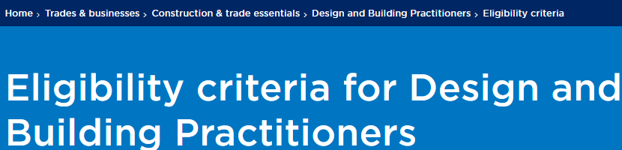
For all classes of designers visit the Fair Trading website
https://www.fairtrading.nsw.gov.au/trades-and-businesses/construction-and-trade-essentials/design-and-building-practitioners/eligibility-criteria

Slide 43
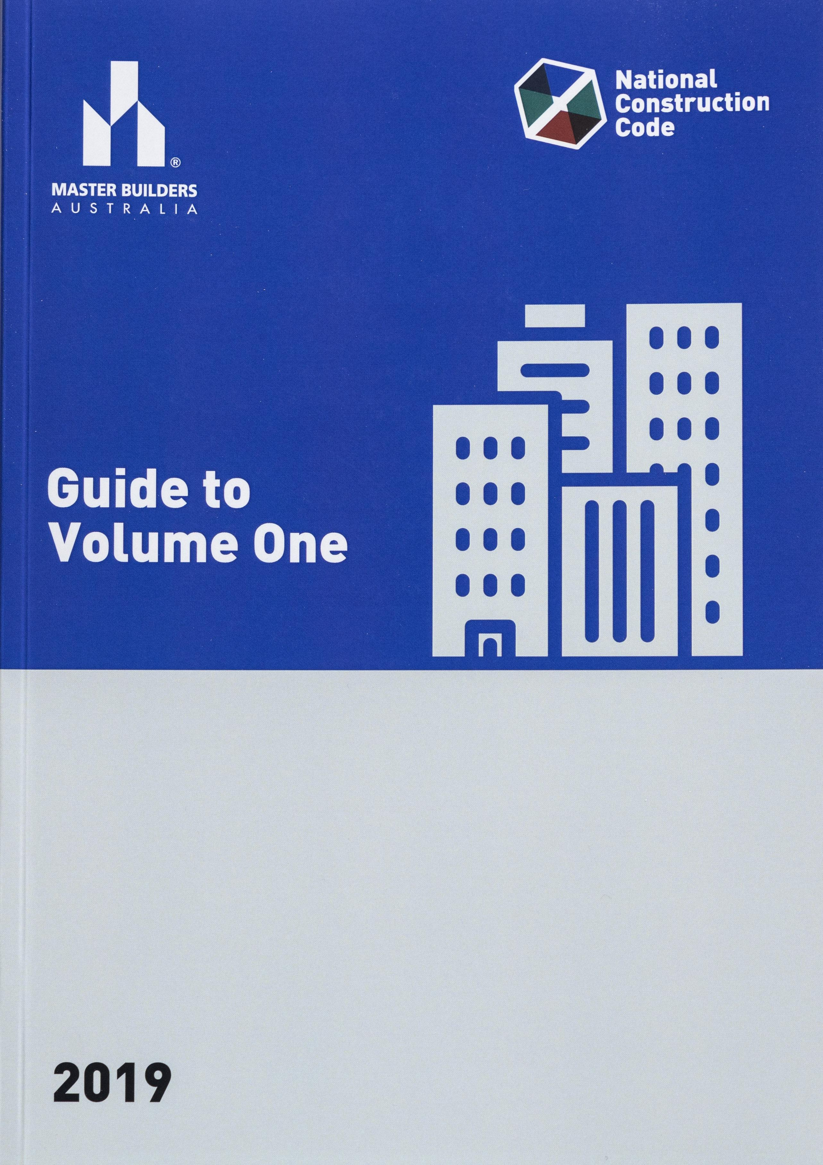
Building Code of Australia
All participants on a construction project must lift their capability and their knowledge of the Building Code of Australia and other standards which relate to their work, especially on the building elements.
Continuing education requirements are being made clearer so that quality courses are available and can be tailored to suit the needs of industry and the new legislation

Slide 44
The rest…

Slide 45
Code of Practice
All Design and Building Practitioners must comply with a Code of Practice that sets out required professional and ethical standards.
The Code includes the duty to:
  act in a professional manner
  act within their level of competence and expertise
  maintain satisfactory level of competence
  avoid conflicts of interest
  maintain confidentiality.
The Code is in Schedule 4 of the Regulation

Slide 46
Continuing Professional Development (CPD)
All Design and Building Practitioners must complete at least 3 CPD hours each year
Must use courses available from the Construct NSW Digital Learning Platform and ABCB NCC CPD system
Written records should be kept as evidence (certificates)
CPD guidelines: https://www.fairtrading.nsw.gov.au/__data/assets/pdf_file/0010/979372/CPD_Guidelines_Practitioners.pdf

Slide 47
Regulation and education

Slide 48
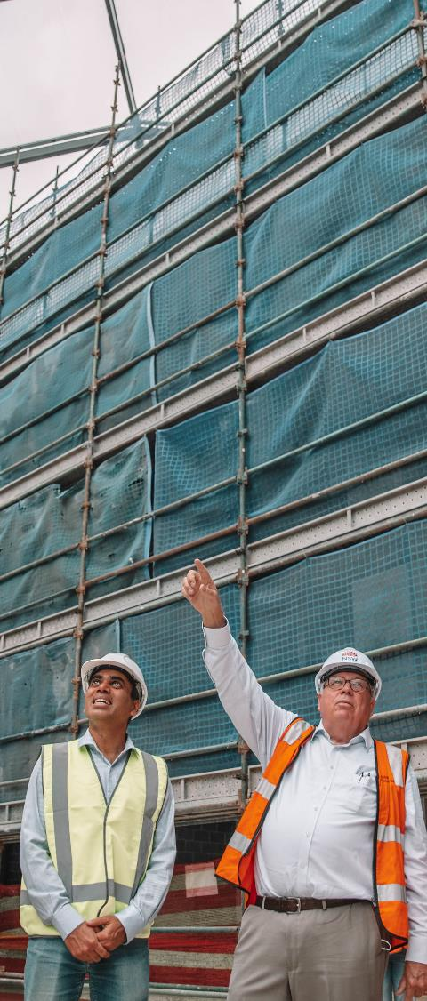



A new approach to compliance from a more proactive regulator
  Audits of building work and designs during construction (pre-OC)
  Using data to focus on the high-risk players and projects
  Multidisciplinary review panel for class 2 complaints
Notes:
Focussed, smarter regulation to help de-risk the market
Enforcing the Certifier Practice Standard

Slide 49
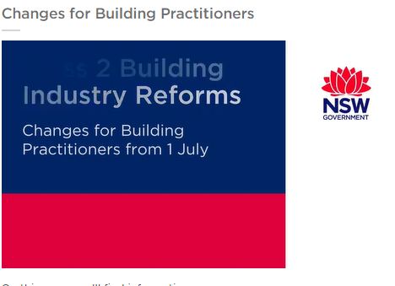
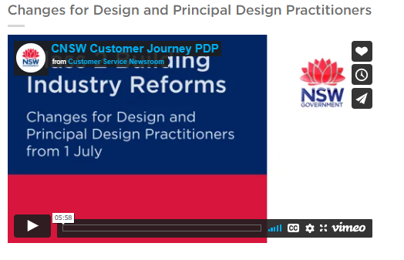
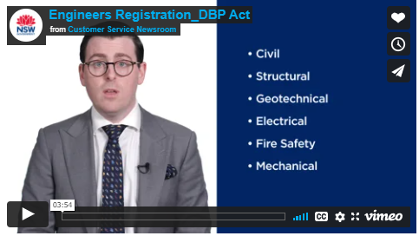

Explanatory videos for builders, designers and engineers
https://www.fairtrading.nsw.gov.au/trades-and-businesses/construction-and-trade-essentials/design-and-building-practitioners/becoming-registered-to-work-on-class-2-buildings

Slide 50










Q&A – OBC here to help restore confidence
Construct NSW Website
Digital Learning Platform
Subscribe to Newsletter
  D&BP – Fair Trading Website
RAB Act
D&BP Act
Case Studies & Research
  DBP – Design & Building Practitioners
  RAB Act Order Register
Certifier disciplinary register
  D&BP Model Clauses
  DBP – Professional Engineers
50

